Slide 1
CMP 2203
LECTURE 2

Slide 2

Number Systems and Codes
Binary Coded Decimal Code
Represent each digit by binary equivalent
4 bits are needed (0-9) e.g.
Note 6 numbers are unusable/forbidden ( decimal 10 – 15); indicate an error if any of them received
Inefficient: some code words not used
Easy

Slide 3
Number Systems and Codes
Gray Code
Digital systems operate at very fast speeds and multiple inputs may change at the same time
e.g. 3 [010] changing to 4 [100]: all bits are changing
To reduce probability of error gray code was developed
Only 1 bit can change between 2 successive numbers
How does it work? [Binary to Gray code]
Binary MSB = Gray coded MSB
If B₂ = B₁, G₁=0, if B₂ ≠ B₁, G₁ =1
Compare B₁ with B₀ etc…

Slide 4
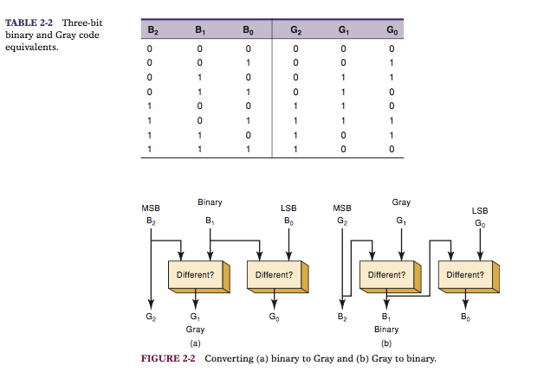
Number Systems and Codes
Image source: Tocci and Widmer
Qn: Convert 13 to Binary , Hex, BCD and Gray

Slide 5
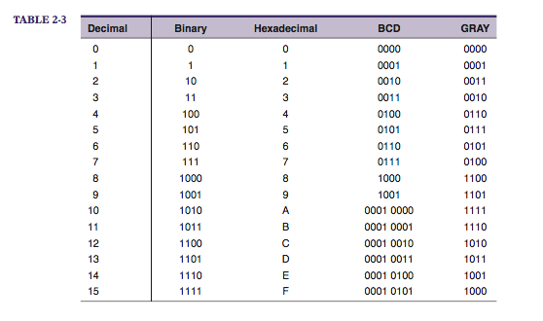
Number Systems and Codes
Image source: Tocci and Widmer
Byte: 8 bits
Nibble: 4 bits
Word: group of bits that represent a certain unit of information.
Word size: number of binary bits in a binary word that a digital system operates on

Slide 6
Alphanumeric codes
Computer must recognize other characters in addition to numbers: letters, punctuation etc.
These codes are called alphanumeric codes
ASCII
American Standard code for Information Interchange
7 bit code ➔2⁷ = 128 code groups
Ref: P. 40 Tocci and Widmer

Slide 7
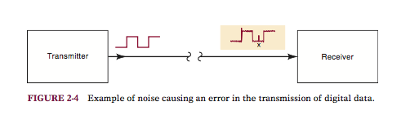
Errors
Occur when information transmitted over any channel due to electrical noise
Distorts signal and may change some bits

Slide 8
Error Detection: Parity method
Uses an additional bit added to the code group ➔parity bit: either 0 or 1
Even parity: choose bit so that the total number of 1’s in the code group is even
e.g. 1 1 0 0 0 0 1 1 or 0 1 0 0 0 0 0 1
Odd parity : number of 1’s is odd
Can detect only single bit errors
Qn: Which is in error assuming odd parity?
1 1 0 0 0 0 0 1 or 1 1 0 0 0 0 0 0
Qn: Which bit was in error?
We don’t know!

Slide 9
Error Detection: Parity method
Qn: What if 2 bits are in error?
Ans: Doesn't’t change even or odd count of 1’s so it wont identify that an error has occurred.
So when is it used?
When probability of a single error very low and that of double errors is 0.
Transmitter and receiver have to agree before hand whether to use odd or even parity

Slide 10
Review Questions
Numbers are entered into a microcontroller based system in BCD and stored in straight binary. As a programmer:
How many bytes would you need if the system takes a 2 digit decimal entry?
How about 3 digits?
Notes:
2 digits can enter up to 99 (1001 1001 BCD) = 01100011 : 8 bits : one byte
3 digits 999 (1001 1001 1001 ) : = 1111100111 (10 bits) : 2 bytes

Slide 11
Review Questions
Consider
:10002000F7CFFFCF1FEF2A95F1F71A95D9F7EA
What is the binary bit pattern (including parity) for :1 (hint : (3A) and 1 (31) ASCII
If there are 10 hexadecimal bytes being loaded into memory. How many decimal bytes are being loaded?
0020 is a 4-digit hex value representing the address where the first byte is to be stored. What is the biggest address possible? How many bits would be needed to represent this address?
If the first data byte has a value F7. what is the binary value of the least significant nibble of this byte?
Notes:
3A, 31: 00111010 10110001
10 hex = 1*16 + 0*1 = 16 decimal bytes
FFFF is biggest value. Each hex digit is 4 bits, so we need 16 bits
Least significant nibble is 7 (4 bits). In binary 0111

Slide 12
Boolean Algebra
Use symbols and operators to describe logical decisions
Logical expressions describe relationship between a logic circuits output (decision) and its inputs (circumstances)
Use Boolean algebra to analyze, simplify and synthesize logic systems
Boolean Constants and Variables
Can only take 2 possible values (0 or 1)
Used to represent states of voltage variables i.e. logic levels and nit actual numbers
Letters will be used throughout this course to represent logic variables

Slide 13
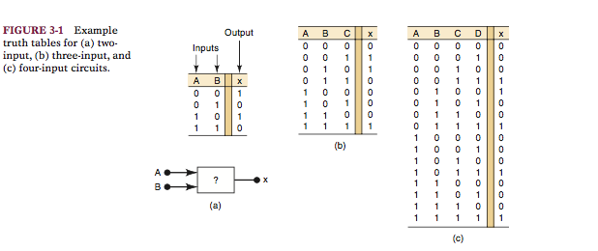
Truth Tables
Used to describe how a logic circuits output depends on the logic levels present at the circuits inputs
Image source: Tocci and Widmer

Slide 14
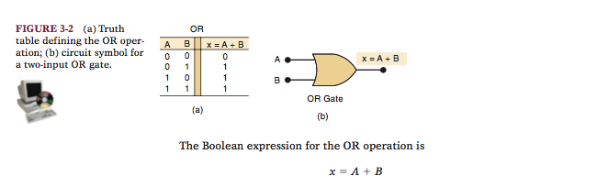
OR operation
X equals A OR B
Image source: Tocci and Widmer
Truth table shows what happens when 2 logic inputs A and B are combined using OR to produce output x
X = 1 when any one or more inputs is 1 and 0 only when both outputs are 0

Slide 15
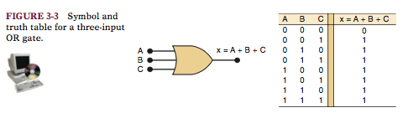
OR gate
Circuit with 2/more inputs and whose output is equal to the OR combination of the inputs
3 input OR gate
Also 1 when 1 or more of the inputs is 1
Image source: Tocci and Widmer

Slide 16
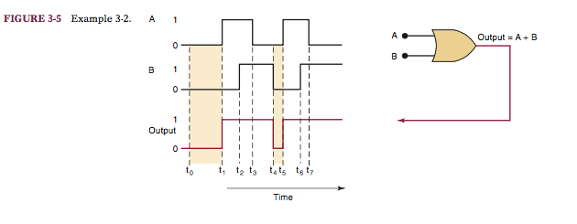
Example
Determine the output
Image source: Tocci and Widmer

Slide 17
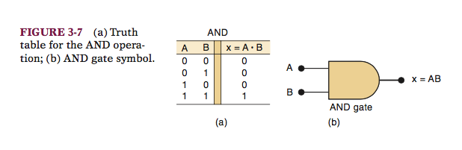
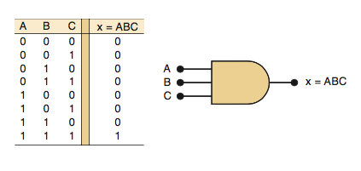
AND Operation with AND Gates
Image source: Tocci and Widmer
X = A.B , X equals A AND B
Output is 0 if any of the inputs is 0
Similar to ordinary multiplication

Slide 18
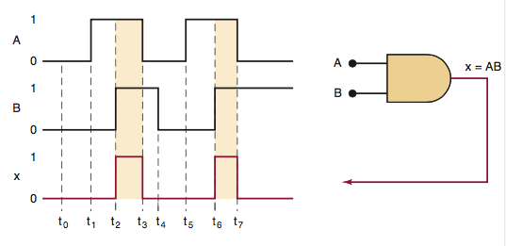
Example
Image source: Tocci and Widmer

Slide 19
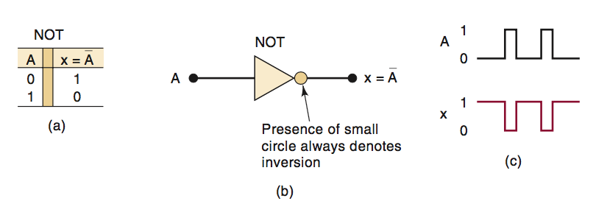
NOT Operation
Only single input variable
X equals NOT A or inverse of A or complement of A

Slide 20
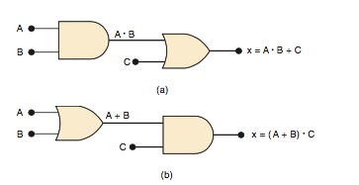
Describing Logic circuits Algebraically
We can describe any logic circuit completely using the 3 basic Boolean operations

Slide 21

Boolean Algebra
Operator precedence:
1. Brackets
2. AND
3. OR
Image source: Tocci and Widmer

Slide 22
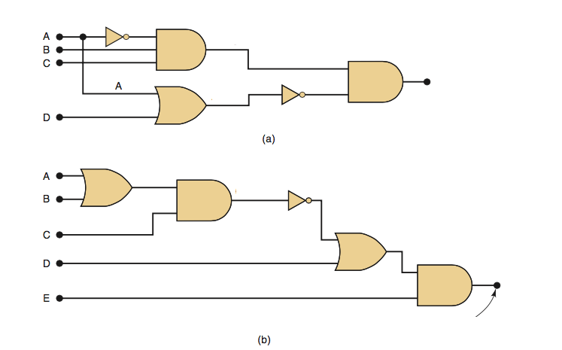
Algebra
X = ?
X = ?
Image source: Tocci and Widmer

Slide 23
References
Ronald J. Tocci, Neal S.Widmer , Digital Systems Principles and Applications , Prentice Hall 2007
Handout. (Read Chapters 1-3)

